Slide 1
Workshop on Data Science
Introduction to Data Science

Slide 2
Today’s Agenda
﻿Introduction to ML
Uses of Data science in real world
Supervised learning Theory
Linear regression
Multiple linear regression
Polynomial regression
Logistic regression
Nb algorithm
Decision tree algorithm
Random forest algorithm
Bonus: Hands on exp of supervised learning concepts

Slide 3
MACHINE LEARNING
Welcome to the Machine Learning

Slide 4
Index
What is Machine Learning?
Why Machine Learning?
Application of ML.
Type of Machine Learning.
What is Supervised Learning?
What is Unsupervised Learning?
Work flow of Machine Learning?
Machine Learning Algorithms.
Implementation.

Slide 5
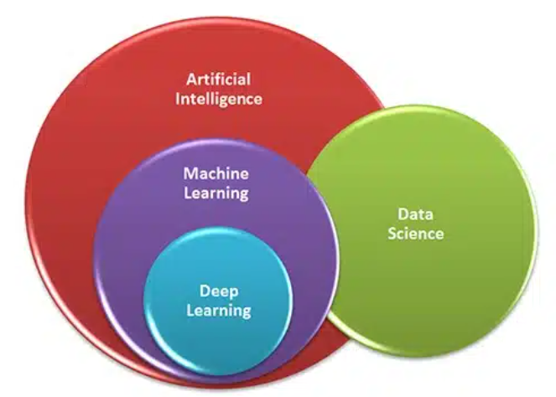
ML vs DL vs AI

Slide 6
ML vs DL vs AI contd.
Artificial intelligence (AI) is related to making machines intelligent and make them perform human tasks. For example self driving car.
Machine Learning is an application of AI. ML is concept which allows machine to learn from example and experience.
Deep Learning is a part of ML which is applied to larger and complex data-sets, it tries to mimic human brain.
Data science is the field of study that combines domain expertise, programming skills, and knowledge of mathematics and statistics to extract meaningful insights from data.
Big Data is if more data getting generated at high speed with many variety and trustworthy then it’s called Big Data.

Slide 7
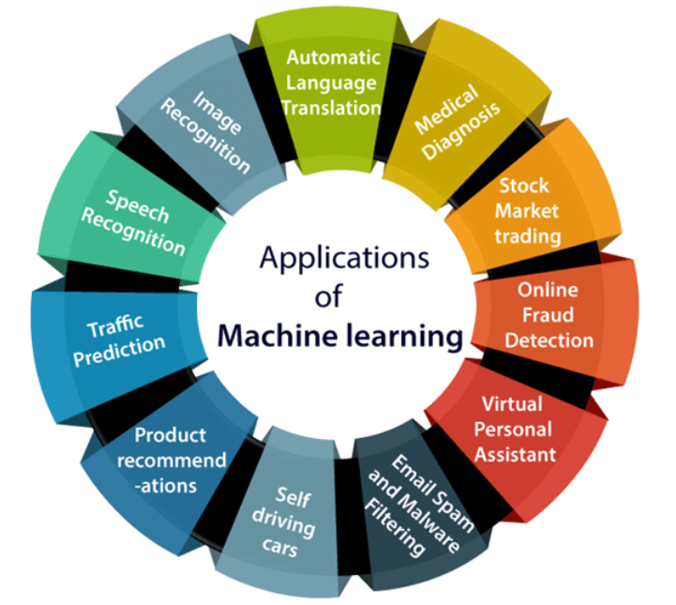
Application of ML

Slide 8

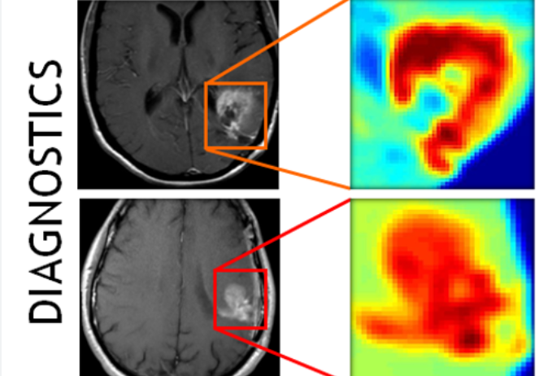
Applications contd.

Slide 9

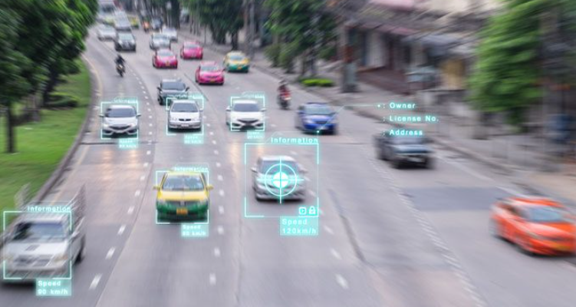
Applications contd.

Slide 10


Applications contd.

Slide 11
Types of Machine Learning
Supervised Learning
Unsupervised Learning
Semi Supervised Learning
Reinforcement Learning

Slide 12
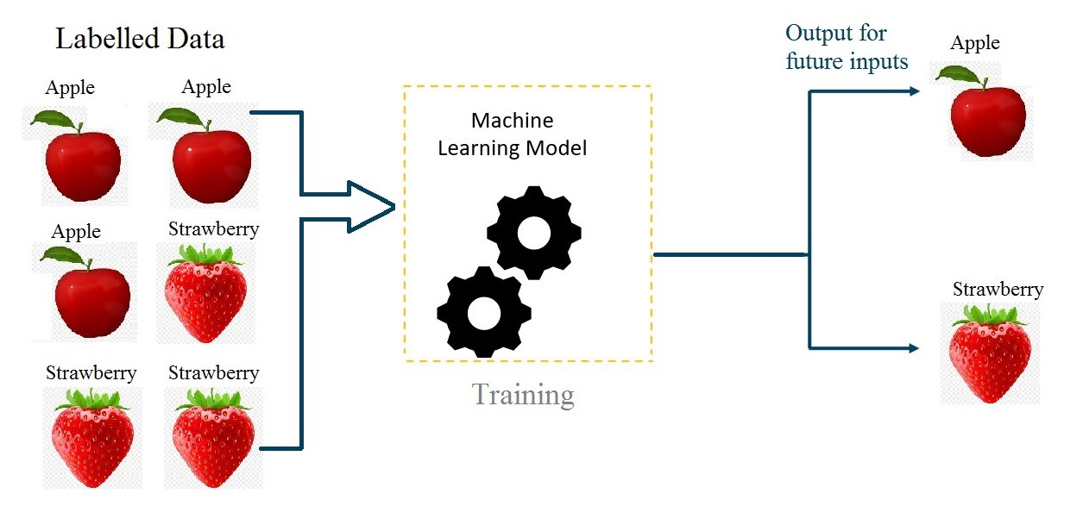
Supervised Learning
Supervised Learning is the one where you can consider the learning is guided by a teacher , we have a dataset which act as a teacher and it's role is to train the model or the machine. Once the model gets trained It can start making a prediction or decision when new data is given to it.

Slide 13
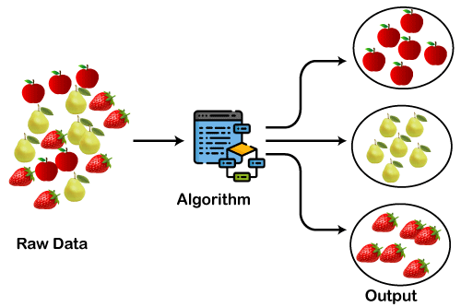
Unsupervised Learning
In unsupervised learning the model learns through observations and finds Structures in the data. Once the model is given a dataset it automatically Finds patterns and relationship in the dataset by creating cluster in it. What it cannot do is and labels to the cluster, like it can not say this a group of apples or mangoes, but it will separate all the apples from mangoes

Slide 14
Reinforcement learning (RL)
Reinforcement learning (RL) is a type of machine learning that enables agents to learn how to behave in an environment by trial and error.
The agent is rewarded for taking actions that lead to desired outcomes, and penalized for taking actions that lead to undesired outcomes.
Over time, the agent learns to take the actions that maximize its expected reward.
RL is often used to train agents to play games, but it can also be used to train agents to perform other tasks, such as controlling robots or managing financial portfolios.

Slide 15
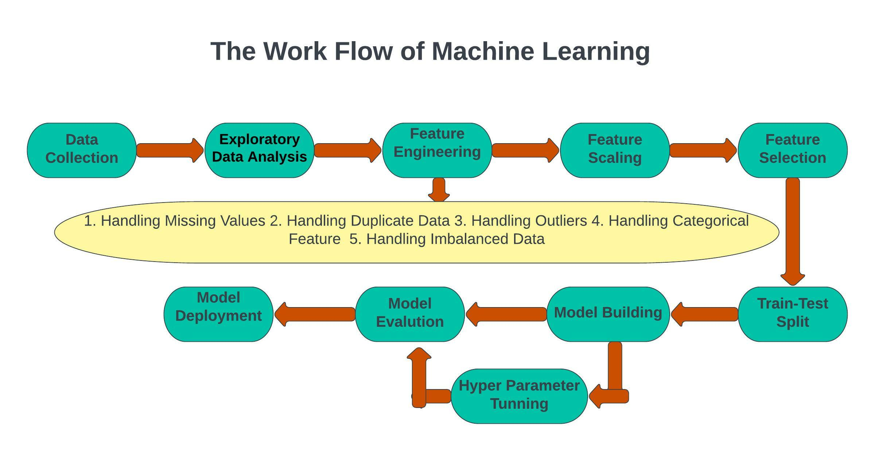
Work Flow of ML

Slide 16
ML Algorithm

Slide 17
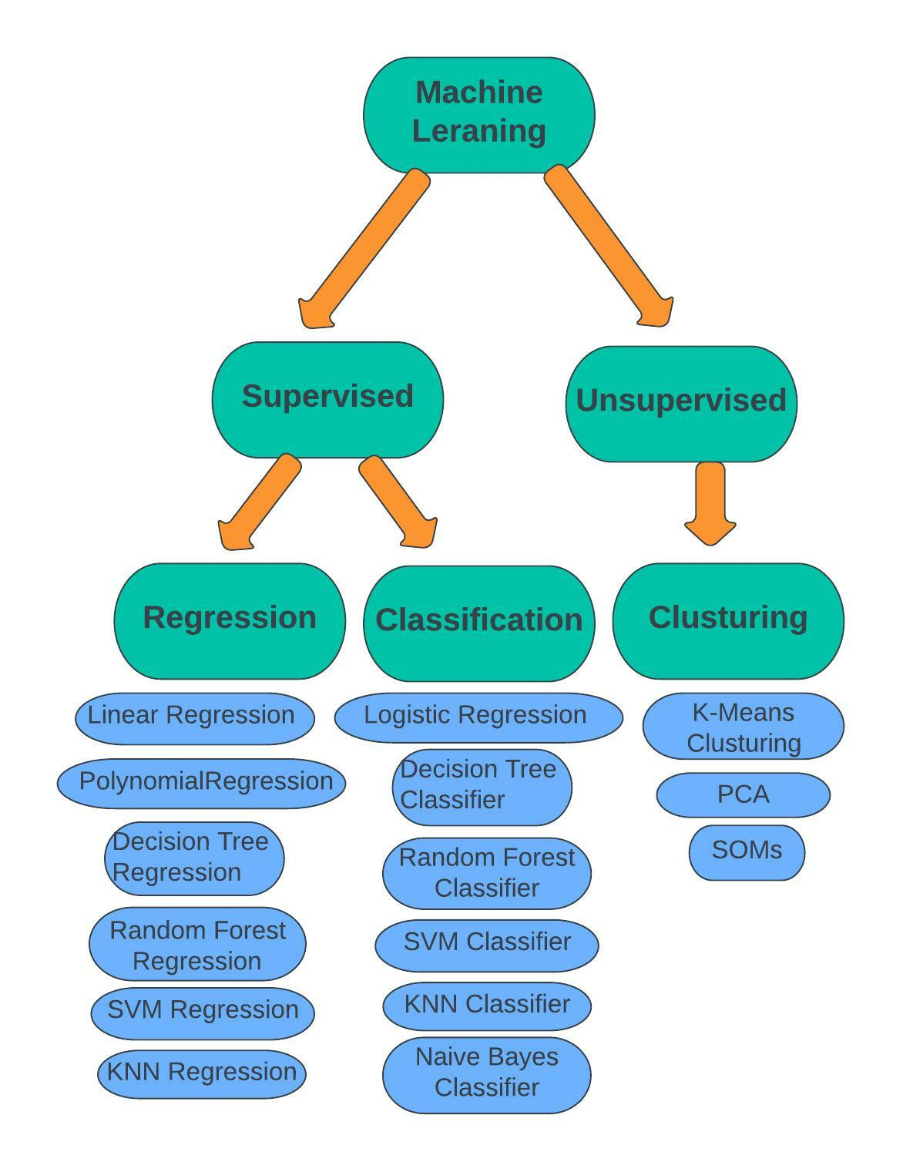

Slide 18
Regression
What is Linear Regression ?
Linear regression is a supervised machine learning algorithm that let us understand the relationship between dependent and independent variables. It predicts continuous value.
example: y = mx + b
Here:
- x = independent variable
- y = dependent variable
- b = bias
- m = slope
By training on many datapoints, the model understands value of b and m.
Then taking any value x, the model can estimate the value y.

Slide 19
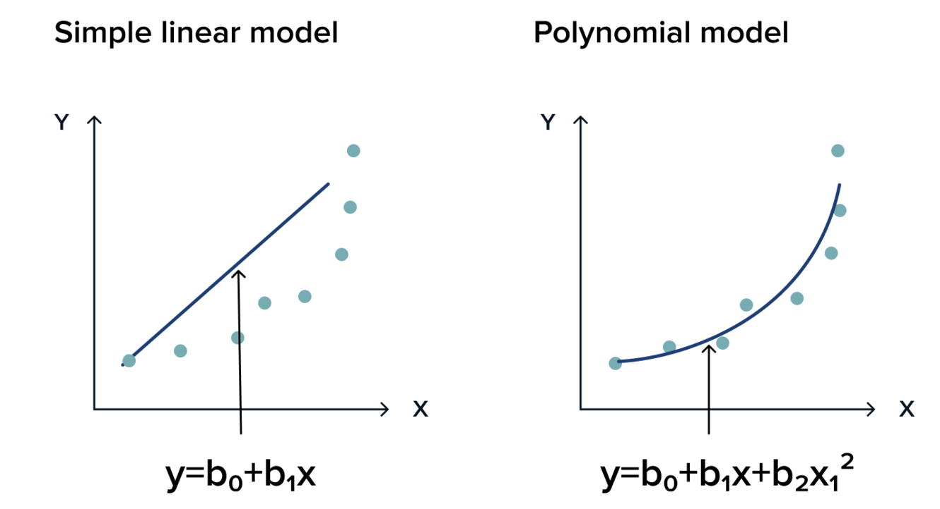
Types of regression
Linear Regression
Multiple Linear Regression
Polynomial Regression

Slide 20
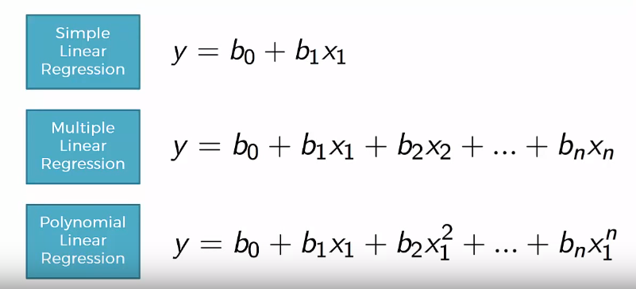
Linear vs polynomial regression

Slide 21
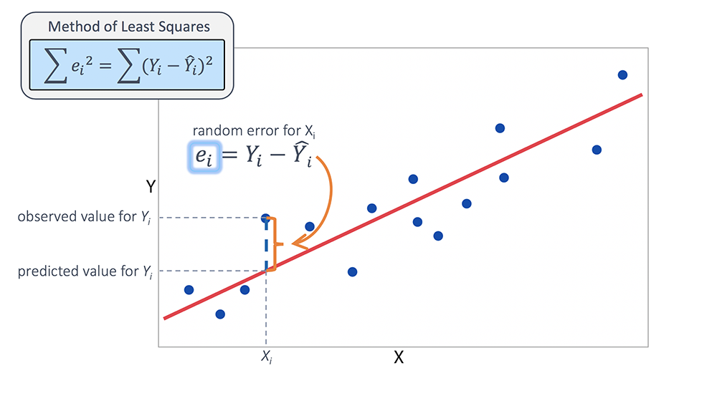
Equation of regression

Slide 22
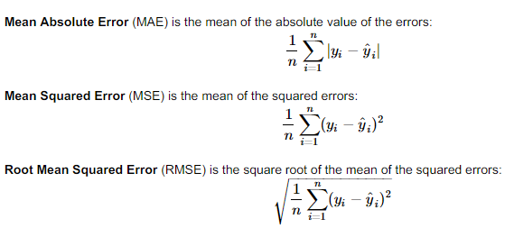
Loss function in regression

Slide 23
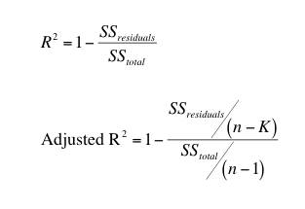
Loss function contd.
R-squared and adjusted R-squared are both statistical measures used to evaluate the goodness of fit of a regression model.
Adjusted R-squared is similar to R-squared, but it penalizes the model for adding additional independent variables.
Value of R-squared and adjusted R-squared are ranges from 0 to 1.

Slide 24
Practical Implementation

Slide 25
Classification task
Machine Learning

Slide 26
Logistic regression
Supervised ML Algorithm

Slide 27
Types of Classification
Binary Classification, Ex: Yes or No
Multiclass Classification, Ex: More than two class
Ordinal Classification, Ex: class in order , Rating(1-5)

Slide 28
Logistic regression
What is Logistic Regression?
Logistic regression is a supervised machine learning algorithm that is used to predict a binary outcome, such as yes or no, based on prior observations of a data set.
Example of Logistic Regression:
Predicting whether a customer will default on a loan.
Predicting whether or not a patient will have a heart attack.
Predicting whether or not an email is a spam.
Predicting whether or not a tumor is malignant.

Slide 29

Logistic regression contd.

Slide 30
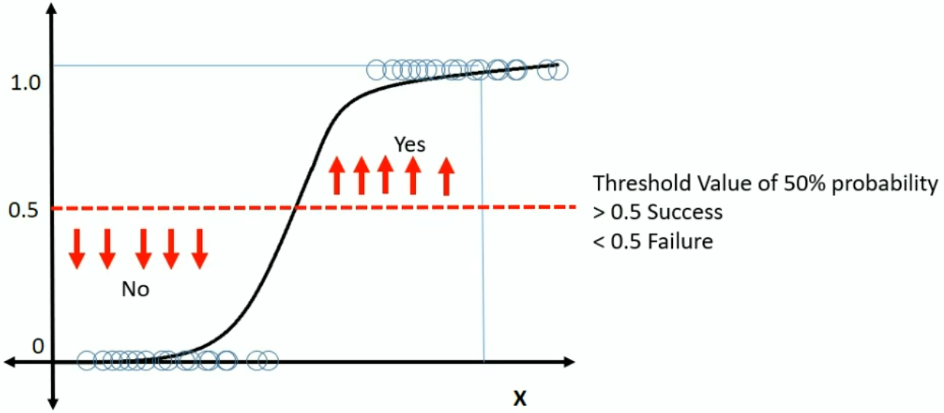
Logistic regression contd.

Slide 31
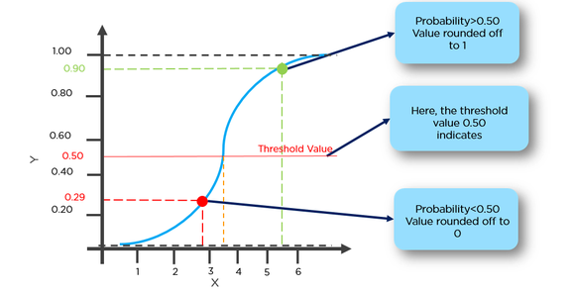
Logistic regression contd.

Slide 32
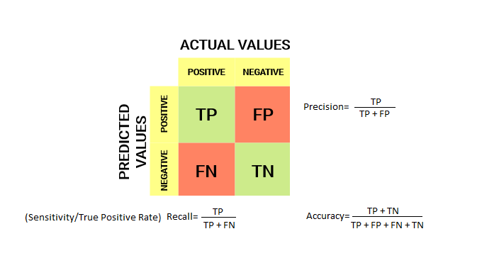
Accuracy and Performance Matrix

Slide 33
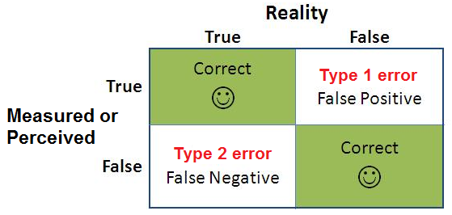
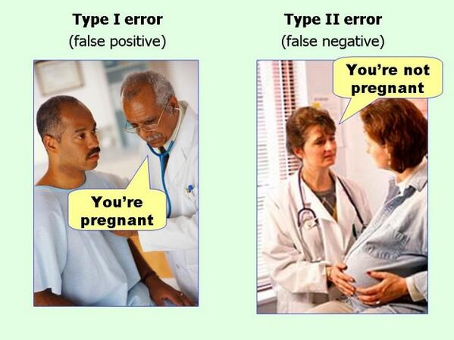
Performance Matrix contd.

Slide 34
Practical Implementation

Slide 35
Decision Tree Algorithm
A decision tree in machine learning is a flowchart-like structure that uses a tree analogy to predict the value of a target variable based on features or attributes. It's a supervised learning technique.

Slide 36
CART Algorithm
Decision Tree Algorithm
Random Forest Algorithm

Slide 37
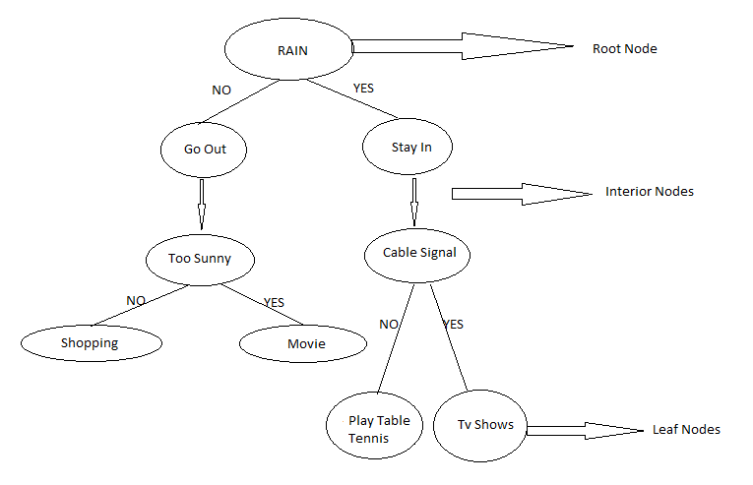
Diagram of DT

Slide 38
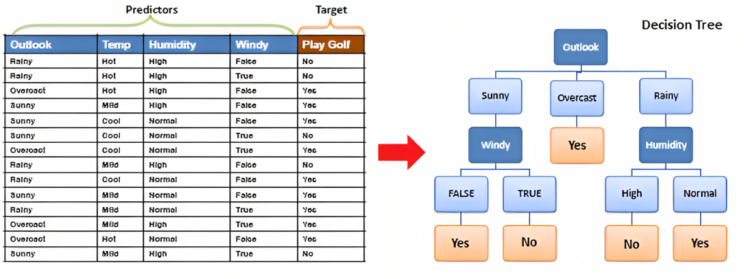
Diagram

Slide 39
Information Theory in DT
Information Gain is used to decide which feature to split.
For each node of Tree Information Gain is calculate.
The split with highest Information Gain will be taken as first split.
The process will continue until Information Gain is zero.

Slide 40
Limitation of DT
Prone to OVERFITTING.
High Variance.
Unstable, if we add new data points it recalculate and reconstruct the Tree.
Can not handle large dimension of data.

Slide 41
Concept of Bias & Variance
Bias: Bias is how far are the predicted values from the actual values.
Variance: Variance occurs when the model performs good on the train data but does not well on the test dataset.

Slide 42
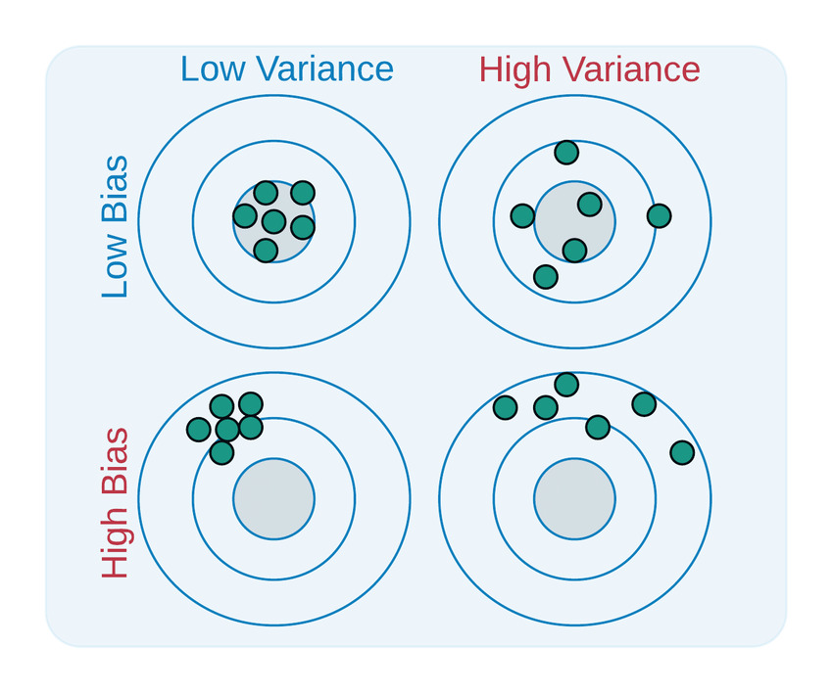
Bias & Variance Diagram

Slide 43
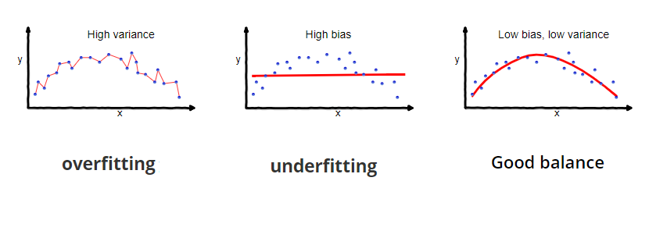
Overfitting and Underfitting

Slide 44

Bias-Variance Trade-off

Slide 45
Avoid Overfitting in DT
Used Pruning Technique to avoid OVERFITTING. (Pruning means cutting down some leaf node)
Post Pruning (after model training)
Pre Pruning (before model training) used as a hyperparameter technique.

Slide 46
Random Forest
Random Forest is an ensemble technique.
Use bootstrap aggregation technique commonly known as Bagging.
Combine multiple decision trees in order to get more accurate final output.
Stable predictions rather than relying on individual Decision Tree.

Slide 47
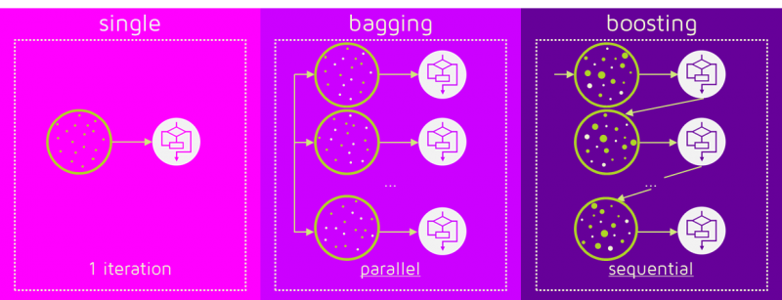
Ensemble Technique

Slide 48

Random Forest Diagram

Slide 49
Advantages of RF
RF models are robust to overfitting.
RF models are robust to noise in training dataset.
RF method is very fast and effective in working with huge dataset.

Slide 50
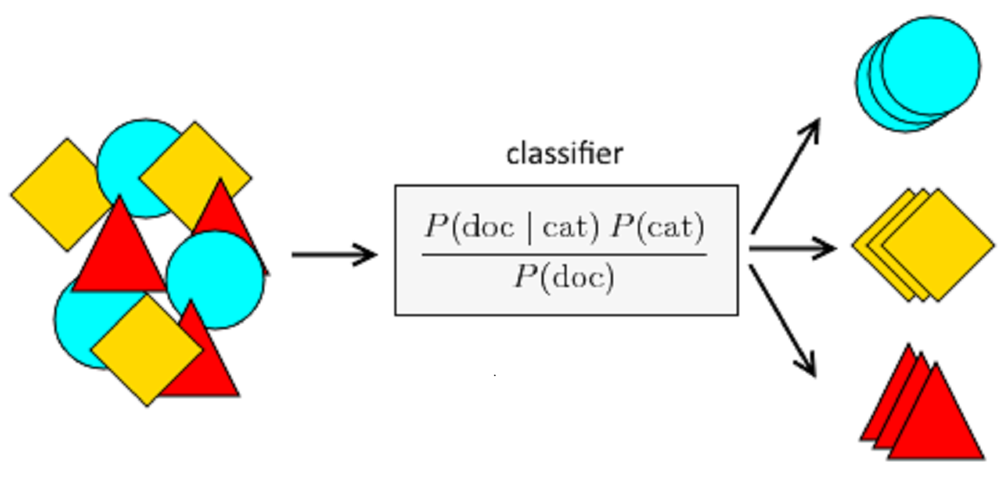
Naïve Bayes
The Naïve Bayes classifier is a simple probabilistic machine learning algorithm based on Bayes' theorem with the "naïve" assumption of independence between features. It's widely used for classification tasks, particularly in text classification and spam filtering.

Slide 51
Naïve Bayes
Pros:
Simplicity and Efficiency: Naive Bayes is a relatively simple algorithm to understand and implement. It also works well with high-dimensional data (data with many features) and requires less training data compared to some other algorithms.
Effectiveness: Despite its simplicity, Naive Bayes can achieve surprisingly good performance on many classification tasks.
Cons:
Naïve Independence Assumption: The assumption of independence between features can lead to inaccurate predictions in some cases.
Sensitivity to Feature Scaling: Naive Bayes can be sensitive to the scale of features. If features have vastly different scales, it can lead to the dominance of features with larger scales during probability calculations.
Applications:
Text classification: spam filtering, sentiment analysis, topic classification
Document classification: categorizing news articles, emails
Recommendation systems: product recommendations

Slide 52
Thank you

